Slide 1
E-Commerce Orders Analysis: Data Cleaning & Exploratory Data analysis
Data Analytics Internship Project | Decode Labs
Iffat Jabeen | October 2026

Slide 2
agenda
Dataset and Goals
Data Cleaning
Charts and Insights
Recommendations
Conclusions

Slide 3
Data Set and Goal
E-commerce orders dataset, cleaned in Excel (Power Query)
Goal: find which products, channels and order sizes drive revenue
Tools: Excel, Python (pandas, matplotlib)

Slide 4
Data Cleaning
Problems found: NULL values, empty rows, duplicate OrderIDs, inconsistent text in PaymentMethod and OrderStatus, Date Column showing ########
Fixes (Power Query): removed NULLs and duplicates, standardized text, fixed date format
New column: TotalSales= Quantity*UnitPrice
Result: clean dataset ready for analysis

Slide 5
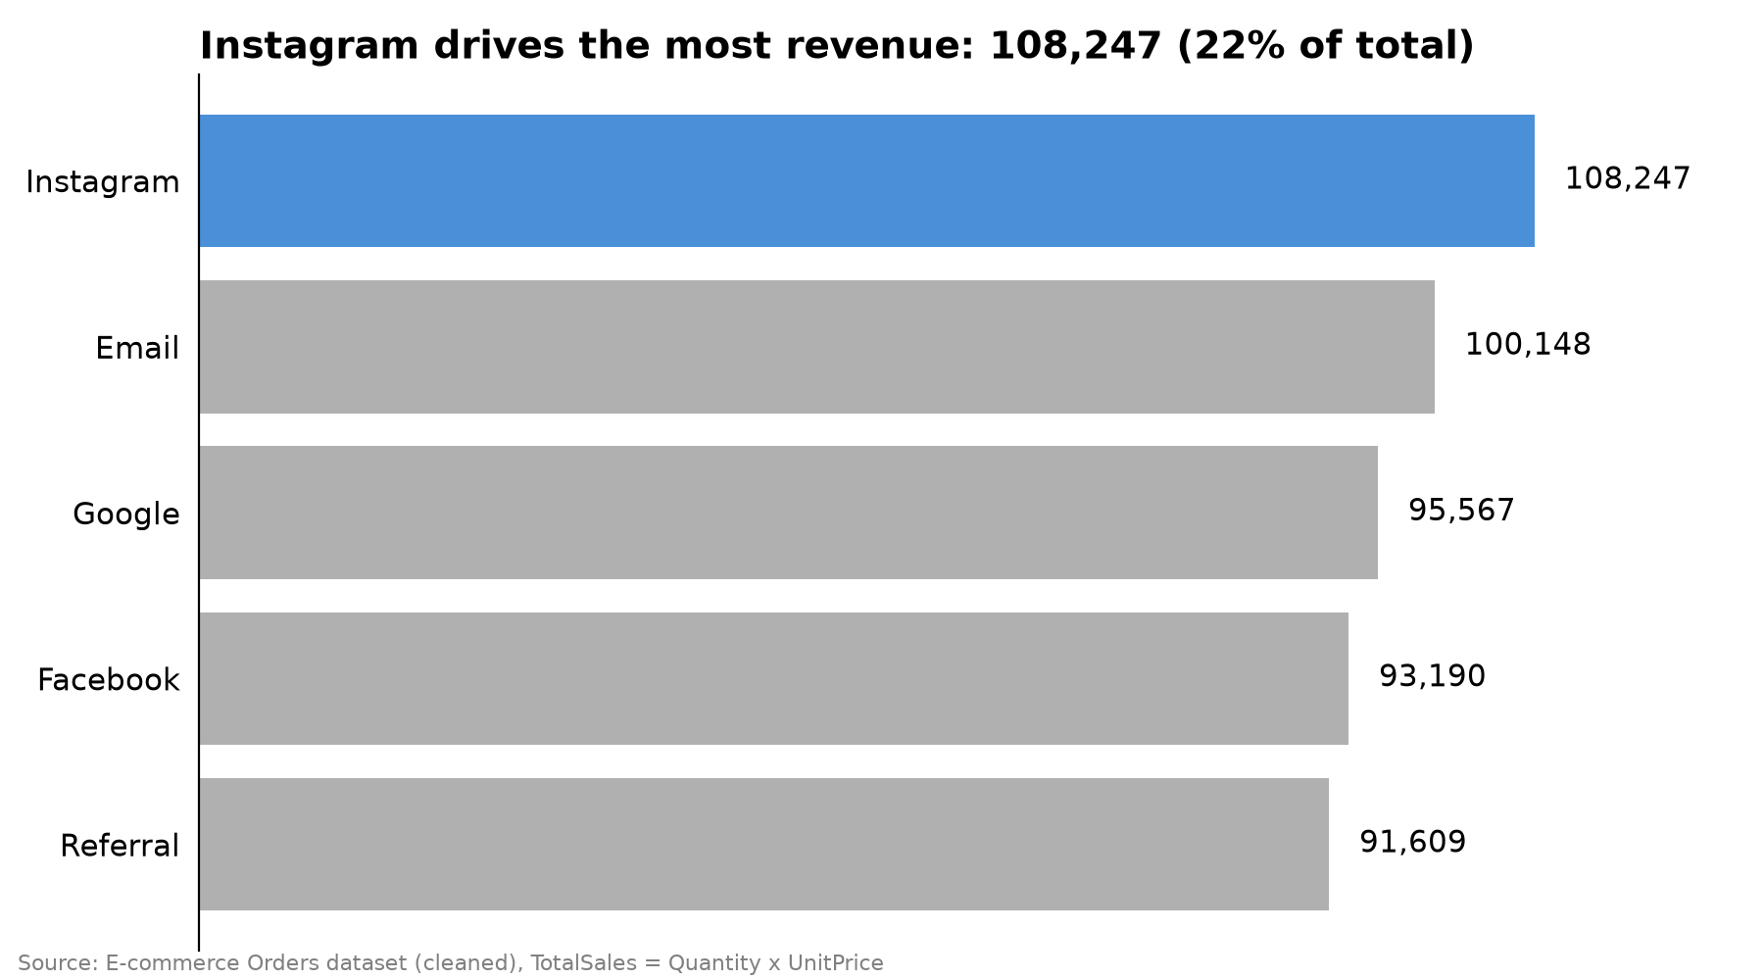
Revenue by Referral Source
Instagram drives the most revenue:108,247 (22% of the total)
Email is second at 100,148 then Google(95,567) and Facebook(93,190)
Referral is lowest at 91,609
Instagram brings about 16,600 more than Referral, so it deserves the most marketing focus.

Slide 6
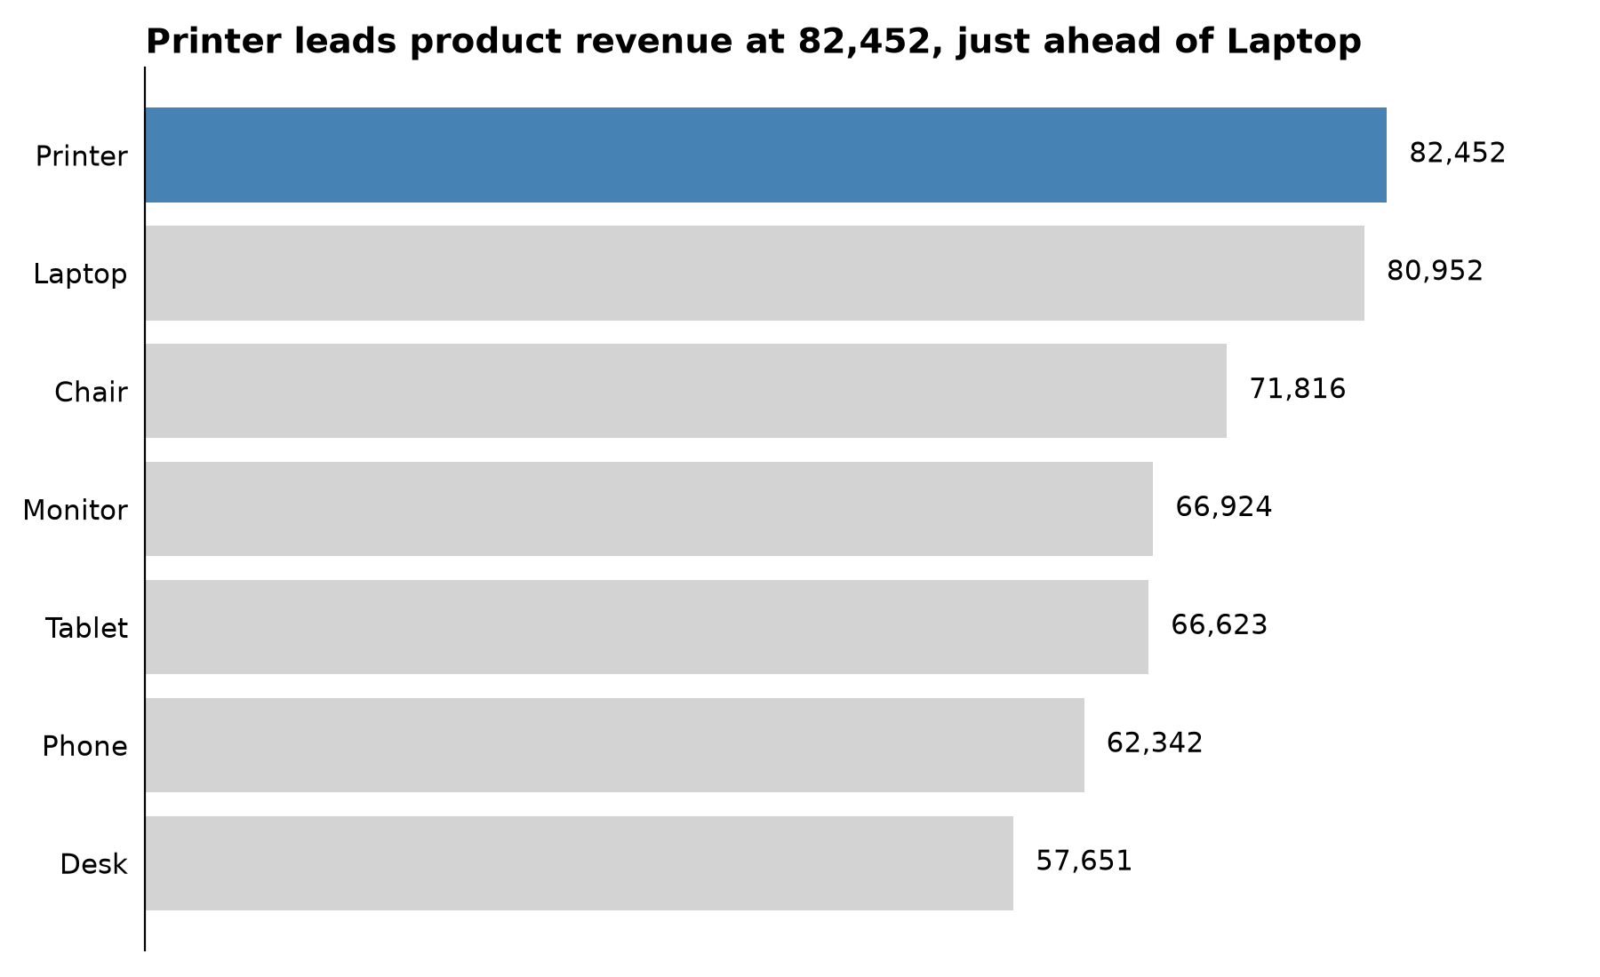
Revenue by product
Printer leads product revenue at 82,452, just ahead of Laptop(80,952)
Chair is third at 71,816, followed by Monitor(66,924) and Tablet (66,623)
Phone (62,342) and Desk (57,651) bring in the least
The gap between the top product and the lowest is about 24,800

Slide 7
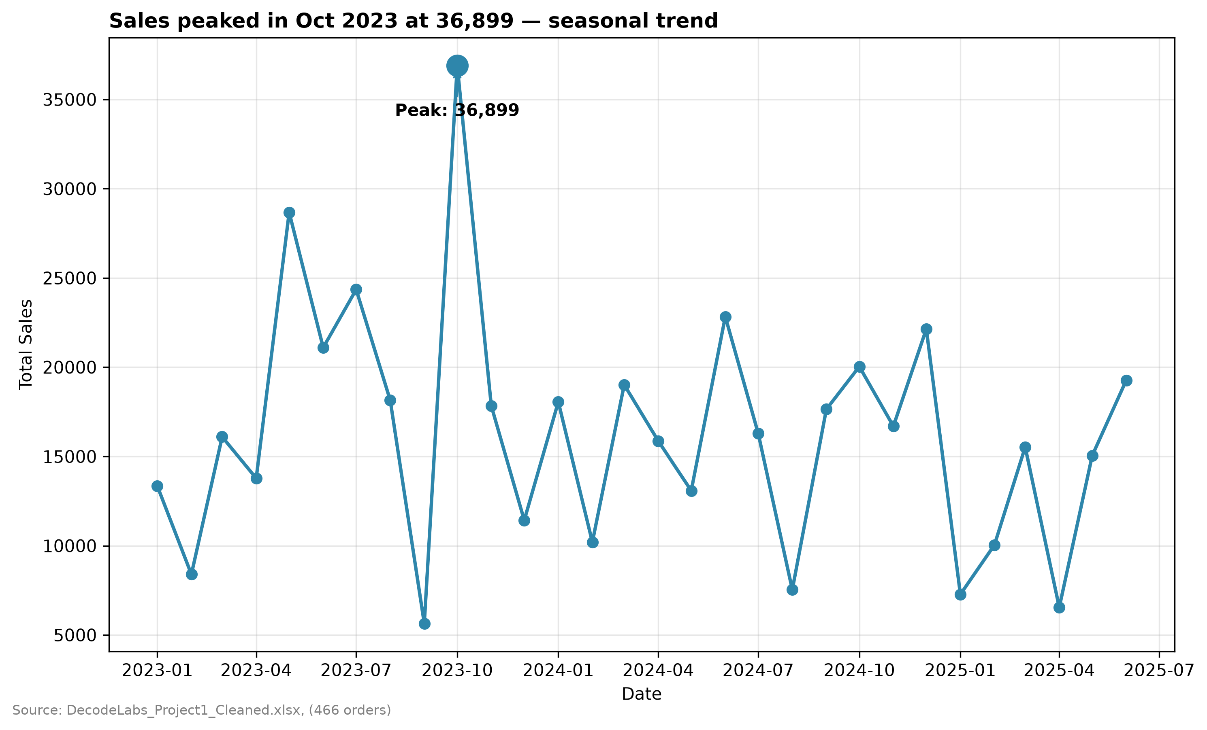
Sales trend over time
Sales peaked in October 2023 at 36,899, the highest month by a wide margin
Monthly sales swing sharply, mostly between about 5,000 and 20,000, which points to a seasonal pattern
No later month came close to the October 2023 peak
The data covers January 2023 to md-2025( check the exact end date against your chart)

Slide 8
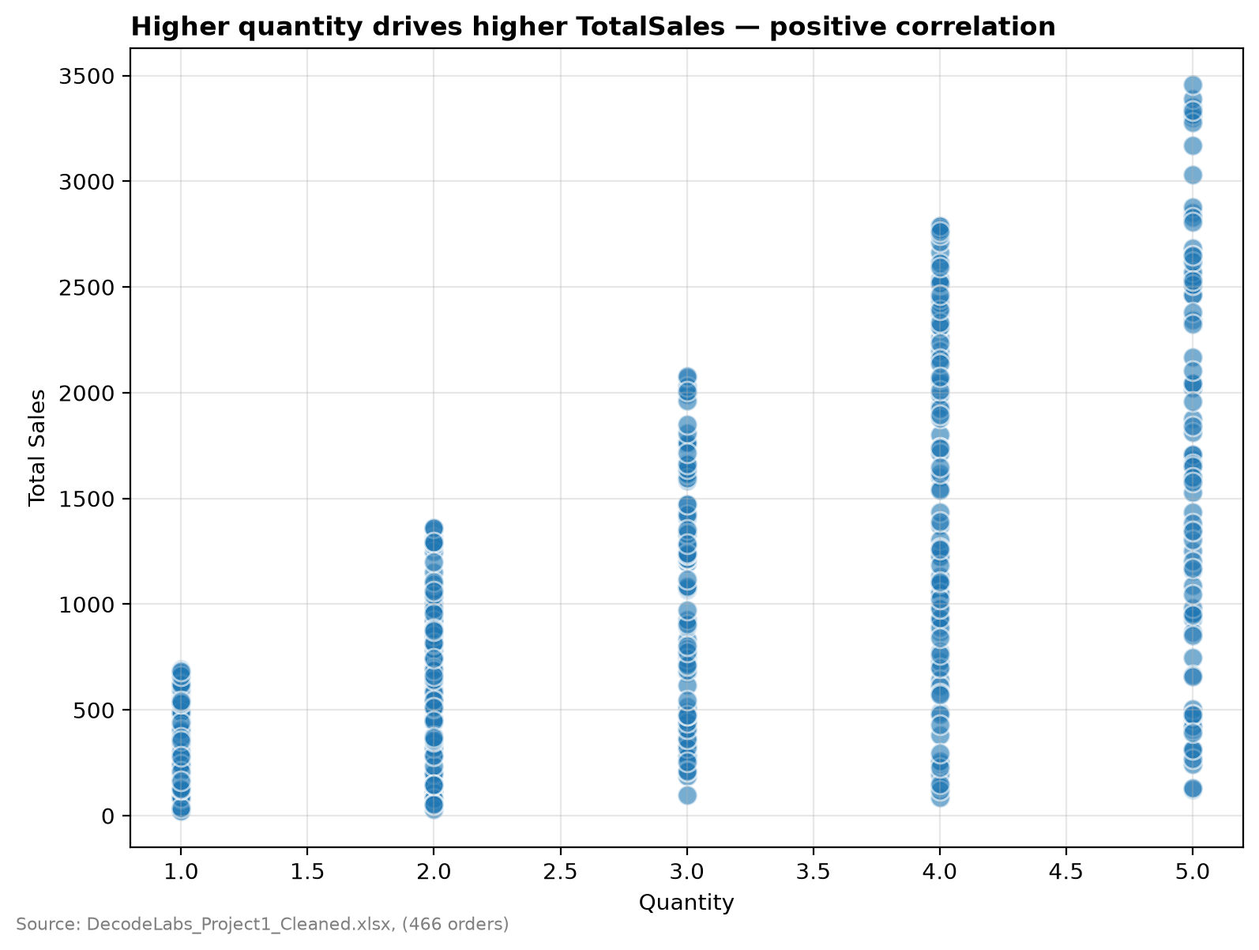
Quantity VS Total Sales
Higher quantity drives higher total sales, a positive correlation
Orders with a quantity of 5 reach the highest sales, about 3,300
The highest sale rises with each quantity step: about 700 at quantity 1,1,300 at 2,1,900 at 3 and 2,400 at 4.
Order value depends on quantity, so bundle offers could lift revenue

Slide 9
Key Insights
Instagram is the top referral source at 108,247 (22% of revenue)
Printer and Laptop lead product revenue at 82,452 and 80,952
Sales peaked in October 2023 at 36,899, which points to a seasonal effect
Higher order quantity leads to higher total sales

Slide 10
Recommendations
Put more marketing budget into Instagram, and test ways to lift Referral
Keep Printers and Laptops well stocked, and promote Desk and Phone
Plan campaigns and stock ahead of peak months
Offer bundles or bulk discounts to raise quantity per order

Slide 11
Conclusion
Cleaning the data made reliable analysis possible
Channel, product, season and quantity each shape revenue
Next step: SQL analysis of the same cleaned dataset

